Slide 1
JavaScript & HTML DOM

Slide 2
Readings
JavaScript HTML DOM @ w3schools.com
JavaScript BOM @ w3schools.com

Slide 3
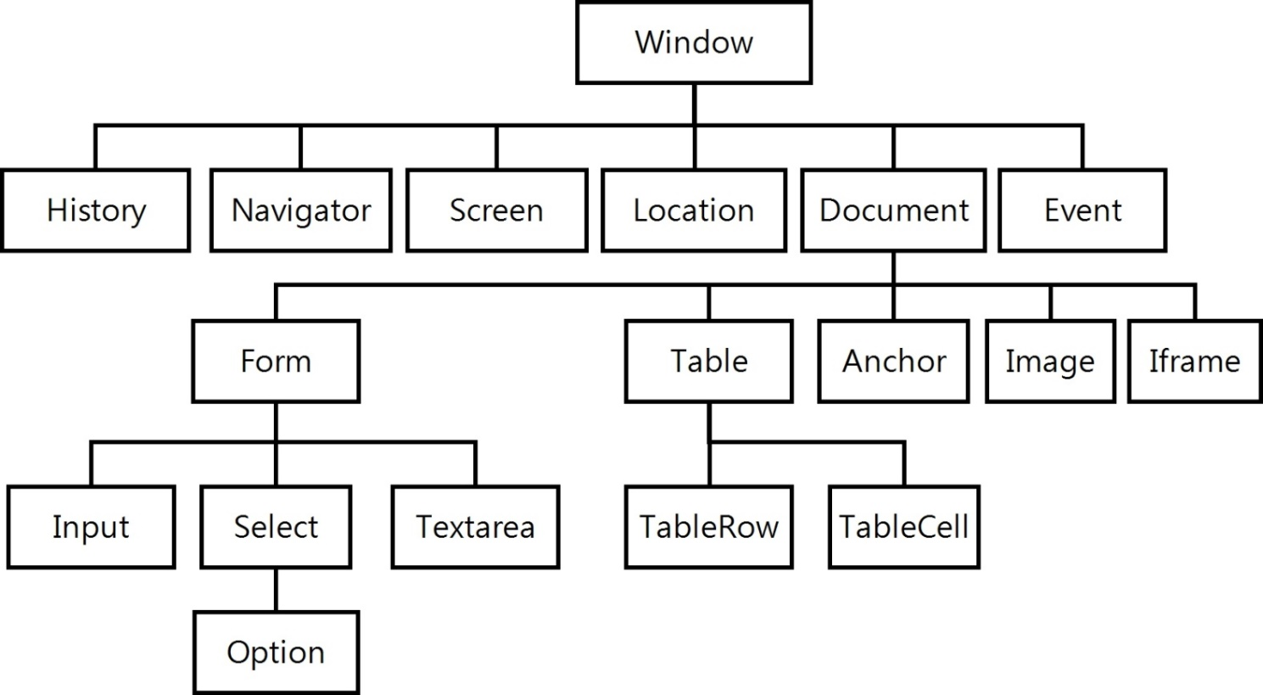
BOM: 瀏覽器物件模型
BOM（Browser Object Model）是一個樹狀結構的物件架構, 以瀏覽器本身的Window物件為根節點：
Document Object
Model (DOM)

Slide 4
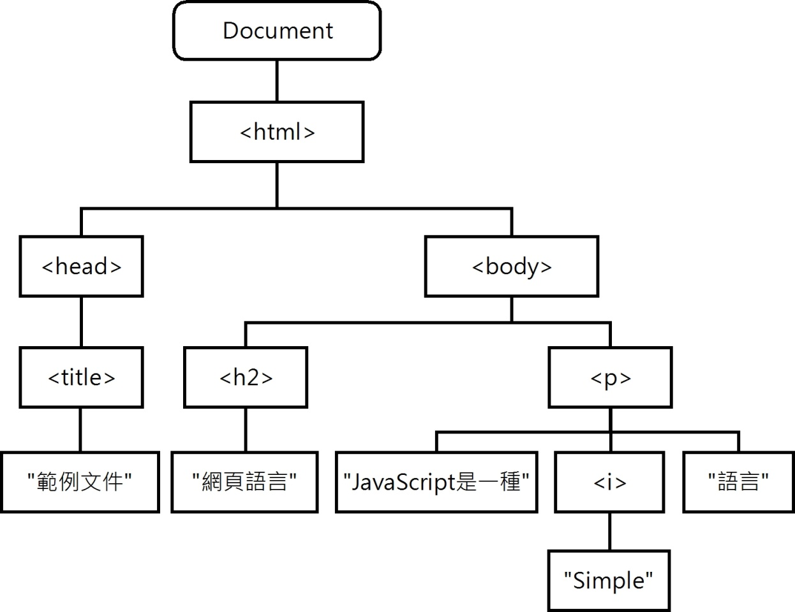
HTML DOM (Document Object Model)
瀏覽器幫每一個載入的網頁建立一個 DOM （文件物件模型）。
<html>
<head>
<title>範例文件</title>
</head>
<body>
<h2>網頁語言</h2>
<p>JavaScript是一種
<i>Simple</i>語言</p>
</body>
</html>

Slide 5
Using JavaScript to Create Dynamic HTML
change all the HTML elements in the page
change all the HTML attributes in the page
change all the CSS styles in the page
remove existing HTML elements and attributes
add new HTML elements and attributes
react to all existing HTML events in the page
create new HTML events in the page

Slide 6
What is the HTML DOM?
The HTML DOM is a standard for how to get, change, add, or delete HTML elements.
It defines
The HTML elements as objects
The properties of all HTML elements
The methods to access all HTML elements
The events for all HTML elements

Slide 7
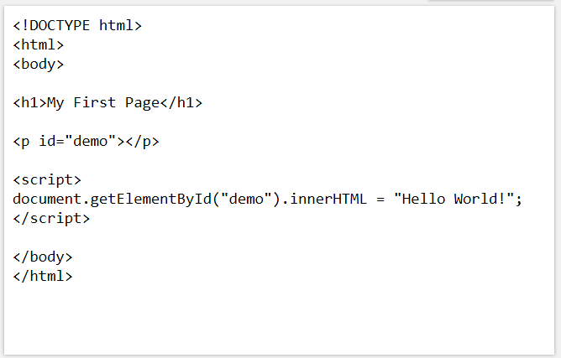
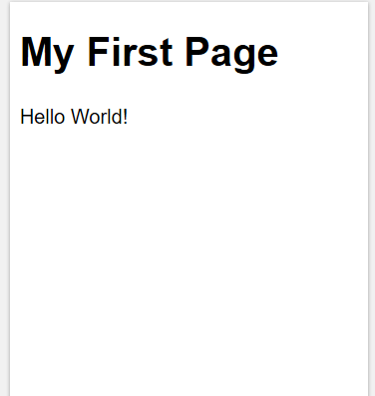
DOM Programming Interface Example
Object.method.property

Slide 8
Finding HTML Elements
Method | Description | return
document.getElementById(id) | Find an element by element id | object
document.getElementsByTagName(name) | Find elements by tag name | Array of objects
document.getElementsByClassName(name) | Find elements by class name | Array of objects
document.querySelectorAll(selector) | Finding elements by CSS selectors | Array of objects

Slide 9
Changing HTML Elements
Method | Description
element.innerHTML = new html content | Change the inner HTML of an element
element.attribute = new value | Change the attribute value of an HTML element
element.setAttribute(attribute, value) | Change the attribute value of an HTML element
element.style.property = new style | Change the style of an HTML element
Html Element Reference; CSS style reference

Slide 10
Adding and Deleting Elements
Method | Description
document.createElement(element) | Create an HTML element
document.removeChild(element) | Remove an HTML element
document.appendChild(element) | Add an HTML element
document.replaceChild(element) | Replace an HTML element
document.write(text) | Write into the HTML output stream

Slide 11
Using Events
Events are “things” happened to elements
Examples:
An element is clicked on
The page has loaded
Input fields are changed
The window is resized

Slide 12
How to make an element invisible
<p id="p1">
This is a text.
This is a text.
This is a text.
This is a text.
</p>
<input type="button" value="Hide text" onclick="document.getElementById('p1').style.visibility='hidden'">
<input type="button" value="Show text" onclick="document.getElementById('p1').style.visibility='visible'">
</body>
</html>

Slide 13
display: “none”; vs. visibility: “hidden”;
Example
What is the difference？
Visible?
Box model

Slide 14
JavaScript HTML DOM Events
Example
<!DOCTYPE html> <html> <body>
<h1 onclick="this.innerHTML='Ooops!'">Click on this text!</h1> </body> </html>
Event Handler （事件處理者)

Slide 15
JavaScript HTML DOM Events
<!DOCTYPE html> <html> <body>
<h1 onclick="changeText(this)">Click on this text!</h1> <script> function changeText(element) { element.innerHTML = "Ooops!"; } </script> </body> </html>
Event Handler（事件處理者)

Slide 16
Assign events to HTML elements
Example: Assign an onclick event to a button element:
<!-- Using HTML Event attributes -->
<button onclick="displayDate()">Try it</button>
<!-- Using HTML DOM -->
<script> document.getElementById("myBtn").onclick = displayDate;
…
function displayDate() { …; } </script>

Slide 17
The onload and onchange Events
Example
<body onload="checkCookies()">
Example
<input type="text" id="fname" onchange="upperCase()">

Slide 18
JavaScript HTML DOM EventListener
Example
Add an event listener that fires when a user clicks a button:
document.getElementById("myBtn").addEventListener("click", displayDate);
Syntax
element.addEventListener(event, function, useCapture);
Optional Boolean value;
Default: False
Event Capturing and Bubbling Example

Slide 19
Add an Event Handler to an Element
Example
Alert "Hello World!" when the user clicks on an element:
<!– Using anonymous function -->
element.addEventListener("click",
function(){ alert("Hello World!");
});
<!– Using named function -->
element.addEventListener("click", myFunction);
function myFunction() {
alert ("Hello World!");
}
只有名稱， 沒有 ( ),
➔ 不用參數

Slide 20
Add Many Event Handlers to the Same Element
Example: add events of the same type to the same element
element.addEventListener("click", myFunction);
element.addEventListener("click", mySecondFunction);
Example: add events of different types to the same element
element.addEventListener("mouseover", myFunction); element.addEventListener("click", mySecondFunction); element.addEventListener("mouseout", myThirdFunction);

Slide 21
Add an Event Handler to the Window Object
Example
Add an event listener that fires when a user resizes the window:
window.addEventListener("resize", function(){ document.getElementById("demo").innerHTML = sometext; });

Slide 22
Passing Parameters
Example
Using anonymous function:
element.addEventListener("click", function(){ myFunction(p1, p2); });
function myFunction(a, b) {
var result = a * b;
…
…
}
Anonymous function

Slide 23
The removeEventListener() method
Example: removes event handlers that have been attached with the addEventListener() method
element.removeEventListener("mouseover", myFunction); element.removeEventListener("click", mySecondFunction); element.removeEventListener("mouseout", myThirdFunction);

Slide 24
Cross-browser solution
Example
var x = document.getElementById("myBtn");
if (x.addEventListener) { //For all major browsers, except IE 8, 7
x.addEventListener("click", myFunction);
}
else if (x.attachEvent) { // For IE 8 and earlier versions
x.attachEvent("onclick", myFunction);
}

